Slide 1
BIO MECHANICS Class :B.S Semester :02 Course Title :Bio mechanics Department : Physical Education Instructor Name: Syeda Maryam Zahra Email.Maryamsyed565@gmail.com / Maryam.zahra@lcwu.edu.pk
Chapter 3

Slide 2
Linear Kinetics of Human Movement Chapter 3 Linear Kinetics of Human MovementBasic Biomechanics, 7th editionBy Susan J. Hall, Ph.D.© 2014 The McGraw-Hill Companies, Inc. All rights reserved.McGraw-Hill/Irwin

Slide 3
What is the law of inertia?
Body will maintain a state of rest or constant velocity unless acted on by an external force that changes the state.

Slide 4
Newton’s LawsFor example
Newton’s Laws For example, a skater has a tendency to continue gliding with constant speed and direction because of inertia.

Slide 5
What is the law of acceleration?
force applied to a body causes acceleration of that body of a magnitude proportional to the force in the direction of the force and inversely proportional to the body’s mass
F = ma

Slide 6
Examples

Slide 7
law of reaction
Newton’s Laws
In accordance with the law of reaction, the weight of a box sitting on a table generates a reaction force by the table that is equal in magnitude and opposite in direction
Newton’s Laws In accordance with Newton’s third law of motion, ground reaction forces are sustained with every footfall during running.

Slide 8
Example

Slide 9
What is friction?
A force acting over the area of contact between two surfaces Direction is opposite of motion or motion tendency Magnitude is the product of the coefficient of friction.

Slide 10
For static (motionless) bodies, friction is equal to the applied force.
For dynamic bodies (in motion), friction is constant and less than maximum static friction.

Slide 11
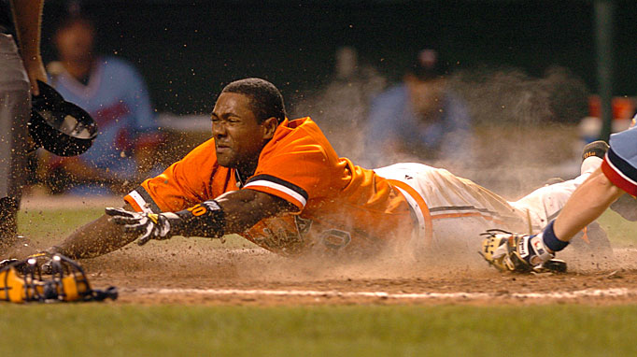
Examples
Upon sliding, the baseball player will come to a complete stop due to the Force of Kinetic Friction
I better be safe Ump!!

Slide 13
coefficient of friction
A coefficient of friction is a value that shows the relationship between the force of friction between two objects and the normal reaction between the objects that are involved.
The coefficient of friction between a dancer’s shoes and the floor must be small enough to allow freedom of motion but large enough to prevent slippage.

Slide 14
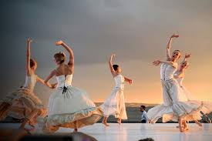

Slide 15
What is momentum?
What is momentum?
Quantity of motion possessed by a body Measured as the product of a body’s mass and its velocity
M = mv

Slide 16
What is the principle of conservation of momentum?
the quantity of motion of a moving body, measured as a product of its mass and velocity.
In the absence of external forces, the total momentum of a given system remains constant.
M1 = M2
(mv)1 = (mv)2

Slide 17
Example
A rugby player mass 90Kg is running at 10m/s. What is the player's momentum?
momentum = 90Kg 10m/s = 900Kgm/s

Slide 18
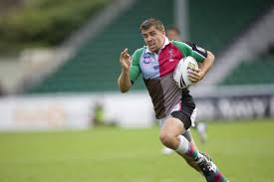

Slide 19
Impulse
To cause greater change to momentum we have to either use greater force for the same period of time, or the same force for a longer period of time.

Slide 20
Examples
Impulse in a javelin throw. Elite athletes are able to apply a force over a longer time frame by leaning back and pulling the javelin from behind the body and releasing it far out in front.
Impulse in the high jump. Elite jumpers lean back prior to take- off which allows them to spend more time applying force to the ground.

Slide 21
How to use impulse of force to increase momentum in sport?
In many sports the elementary motor task is to change as much as possible the velocity of human body, its parts, or of an object. In throwing, kicking, tossing, and jumping the projectiles at the beginning of their motion have zero velocity. When fulfilling a motor task, for example throwing javelin, we are trying to give the javelin at the end of our motion the greatest possible velocity. We are therefore trying to increase the momentum of the javelin. The same follows for certain strokes in tennis, boxing and other sports. The important thing is that to change momentum we have to either use greater force or increase the duration of the same force.
The greater the impulse of force, the greater the change to momentum of a body (projectile, human body, tennis racket, ball, etc.)

Slide 22
What is impact?
The exchange of a large force during a small time interval
Bounce heights of a basketball, golf ball, racquetball, and baseball dropped from a height.

Slide 23
What is mechanical work?
The product of a force applied against a resistance and the displacement of the resistance in the direction of the force work
W= Fd
J (joule)

Slide 24
What is mechanical energy?
What is mechanical energy?
The capacity to do work Units of energy are Joules (J)There are three forms energy
:Kinetic energy
Potential energy
Thermal energy

Slide 25
